Slide 1
Unit 5
Lecture 3

Slide 2
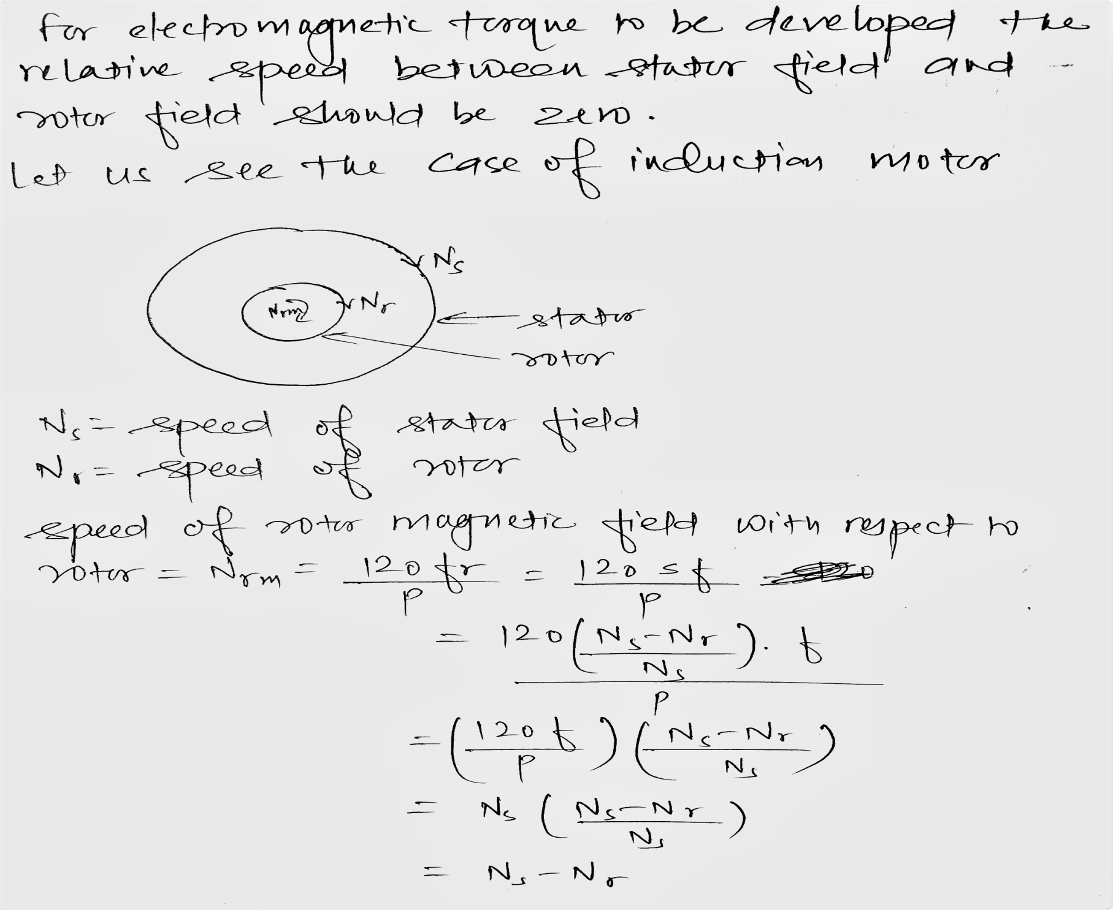

Slide 3
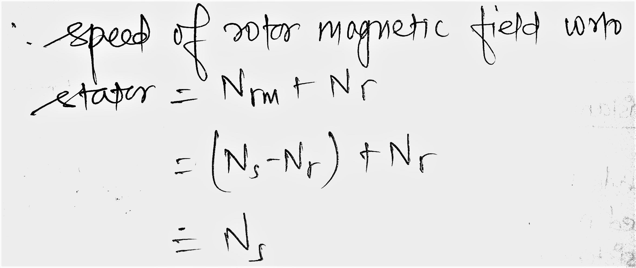

Slide 4
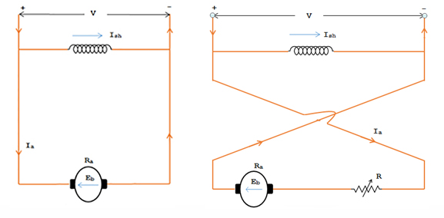
Plugging or reverse current braking in dc shunt motor

Slide 5
Plugging or reverse current braking in dc shunt motor(contd)
In Plugging the armature terminals or the supply polarity of a separately excited or shunt motor when running are reversed.
The reverse torque can be achieved either by reversing the armature winding or field winding. Since the time constant of field winding is large for a shunt motor it is preferrable to reverse the connection of armature winding.
Therefore, in Plugging the supply voltage V and the induced voltage E_{b} which is also called back EMF will act in the same direction.
Thus, during plugging the effective voltage across the armature will be (V + E_{b}) which is almost twice the supply voltage. The armature current is reversed, and a high braking torque is produced.
An external current limiting resistor is connected in series with the armature to limit the armature current to a safe value.

Slide 6
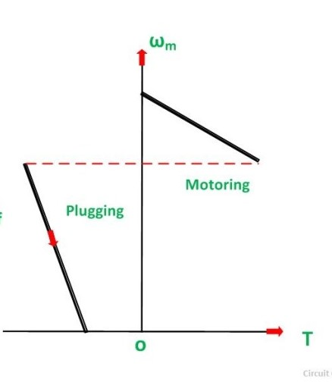
Speed torque characteristic during motoring and plugging mode of dc shunt motor

Slide 7
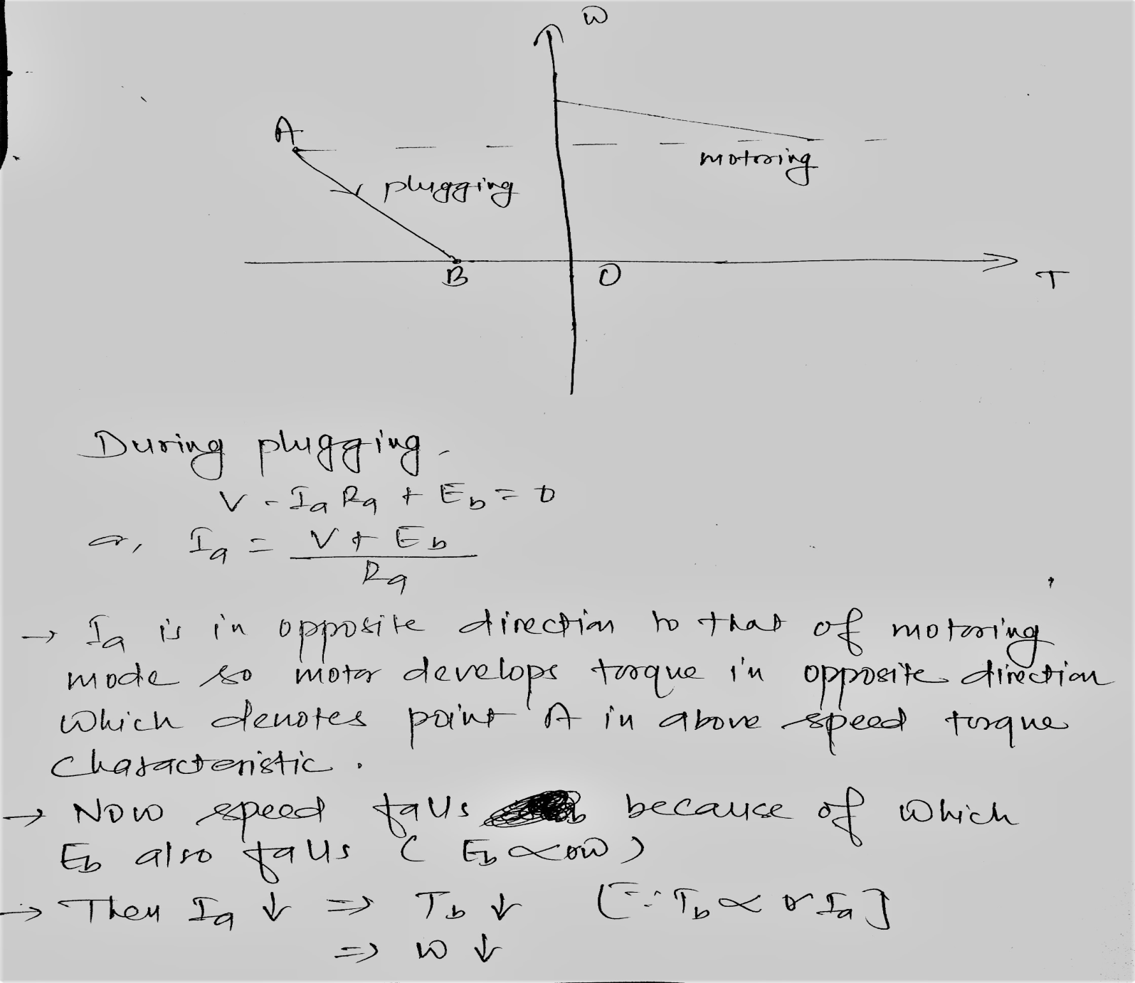

Slide 8
At the point when w=0 denoted by point B we
have to cut off the supply otherwise motor
starts rotating in reverse direction because of
torque given by OB in speed torque
charateristic.

Slide 9
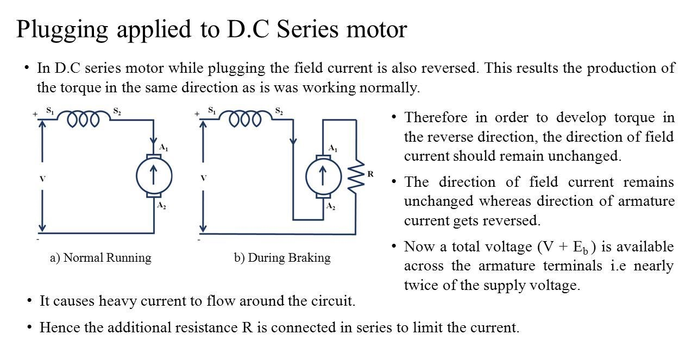

Slide 10
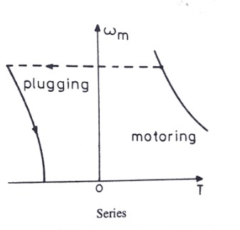
Speed torque characteristic during motoring and plugging mode of dc series motor

Slide 11
Plugging in 3 phase induction motor
For plugging we have to reverse the phase sequence of 3 phase induction motor.
Phase sequence can be reversed by interchanging the connection of two phases.
When the phase sequence is reversed the direction of stator current and hence the direction of rotating magnetic field in stator is also reversed. Due to this, direction of torque is reversed and this torque is known as Braking torque.
The Braking torque reduce the speed of the motor to standstill. If the supply terminal is not disconnected at this stage, then the braking torque accelerates the motor in the anitclockwise direction.

Slide 12
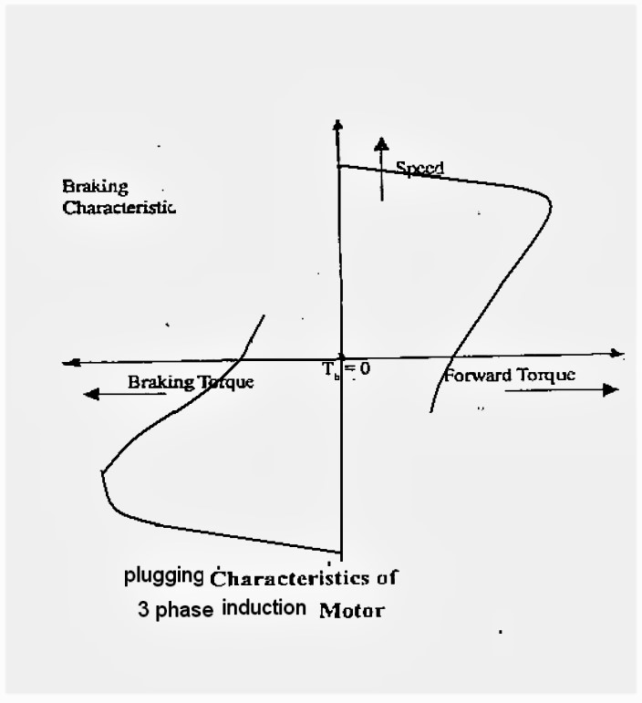
Speed torque characteristic of 3 phase induction motor during motoring and plugging mode.

Slide 13
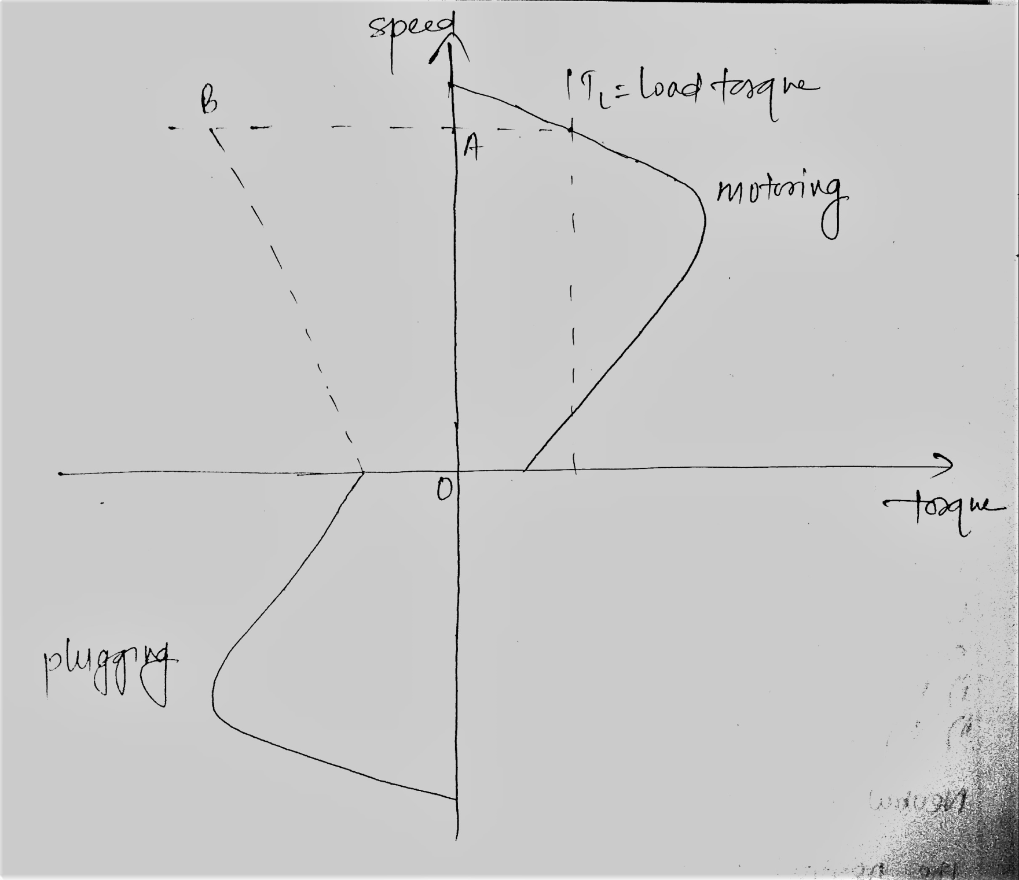

Slide 14
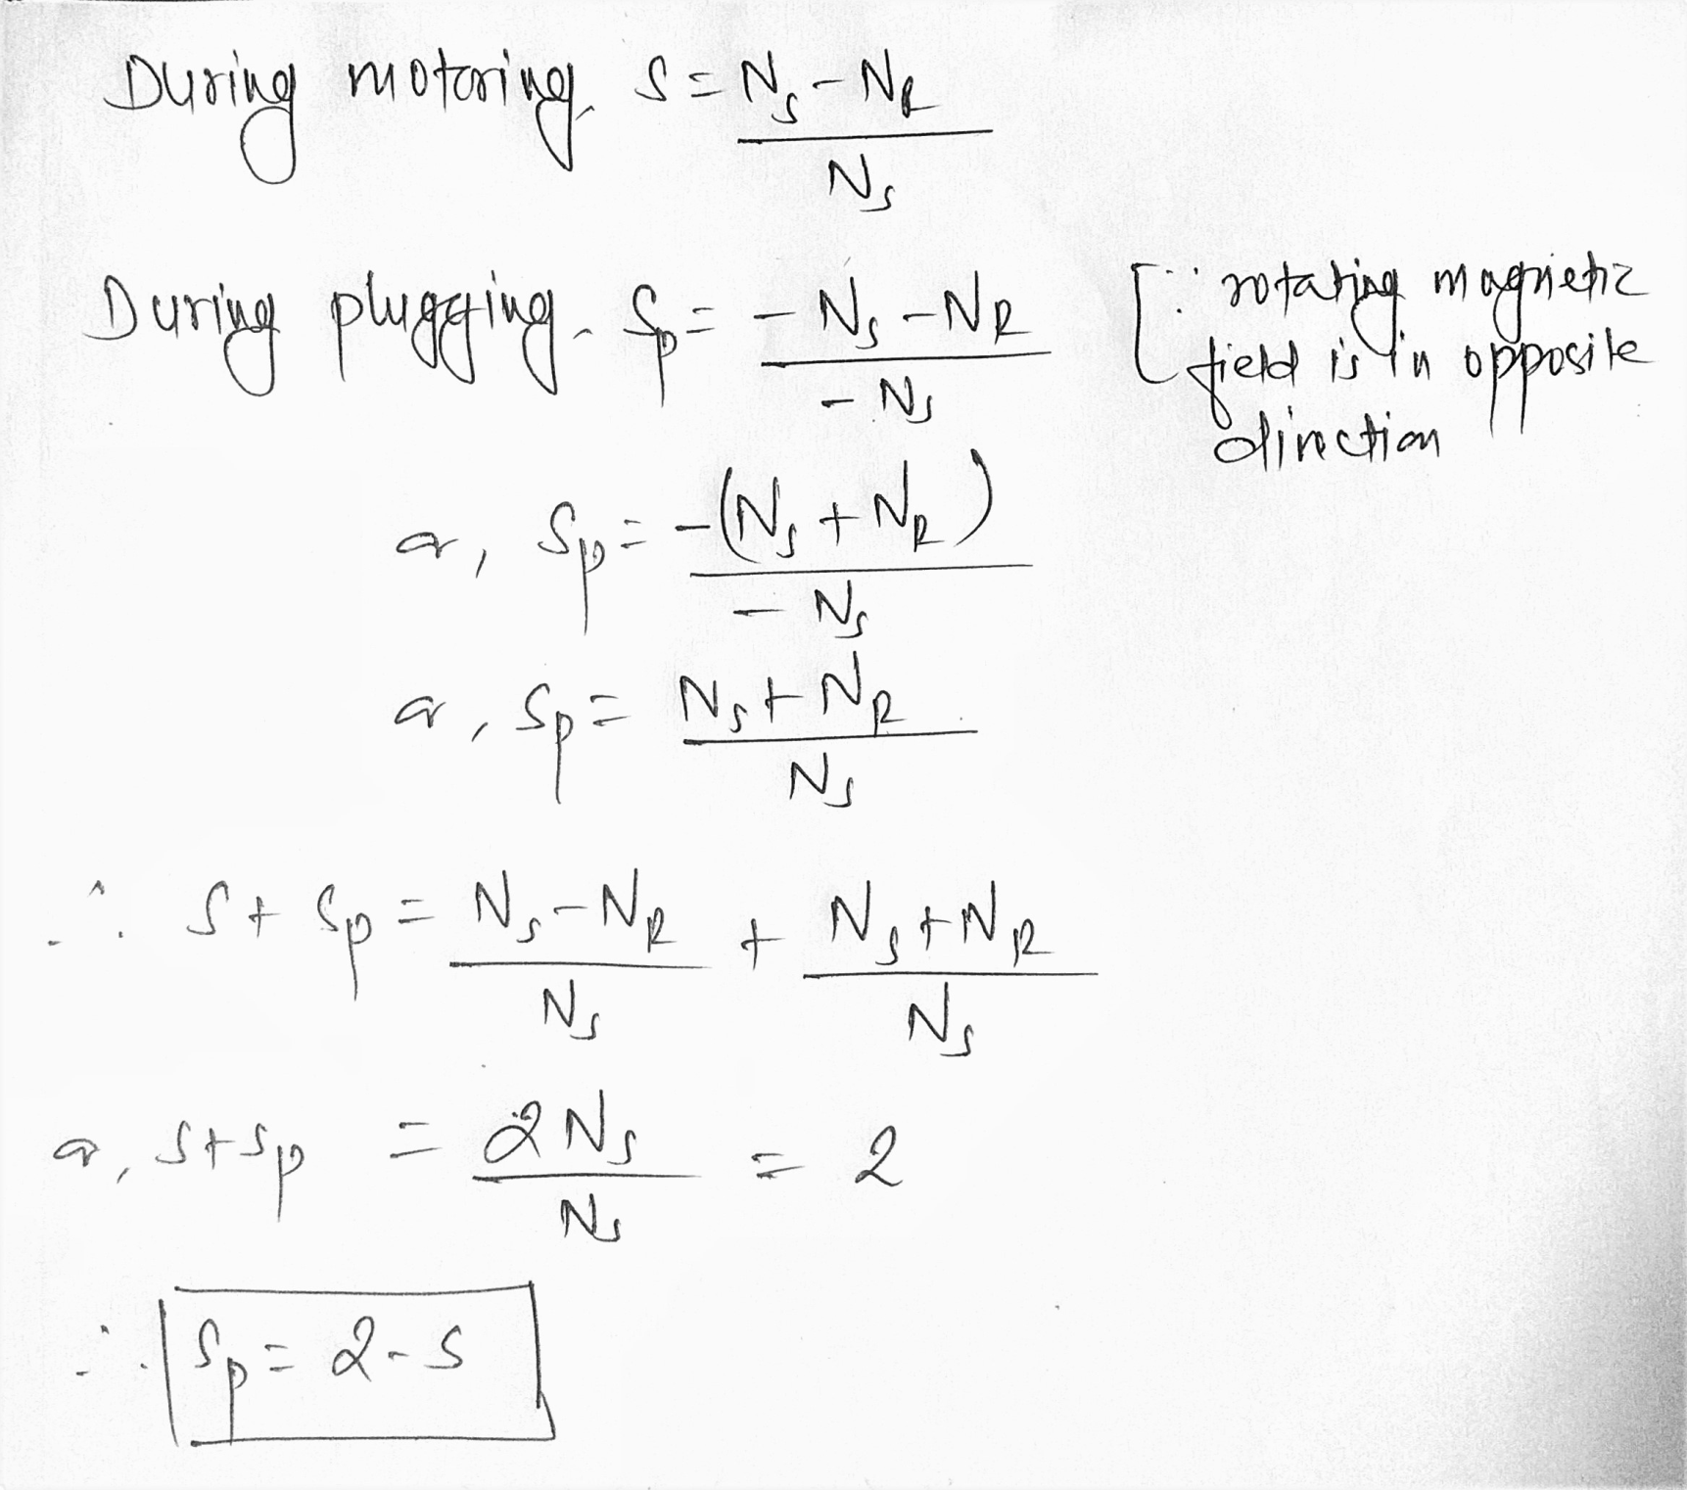

Slide 15
Also we can see that during plugging operation the relative speed between stator field and rotor is high( i.e. N_{S}+N_{r} )
So flux linkage is very high and high amount of current is drawn in rotor winding.
Hence high amount of heat is generated in rotor winding which can melt the rotor winding. It is its demerit.
Its advantage is that it is the fastest braking technique

Slide 16
Dynamic braking of dc shunt motor

